Slide 1
ADHD Diagnosis and Race
Vidhya, Hannah, Blake, and Aishi

Slide 2
Part I: What and Why are You Doing This?

Slide 3
Is there a significant relationship between ADHD diagnosis and race, and has it changed between 2000 and 2020?
Could household income also have a correlation with both race and ADHD diagnosis?
Our Question:

Slide 4
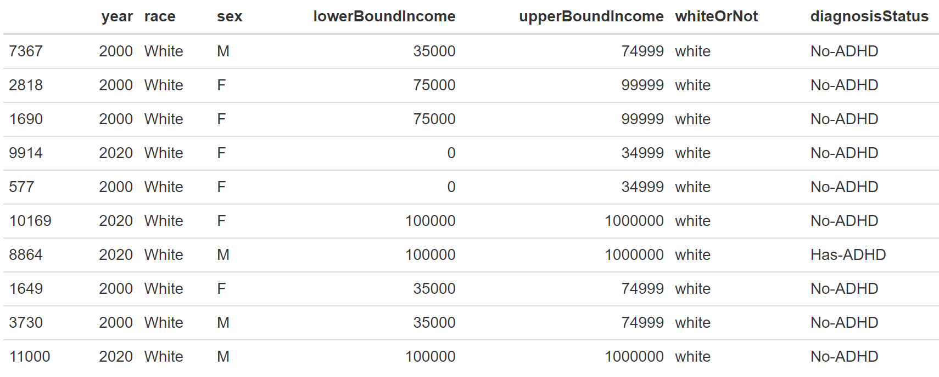

Slide 5
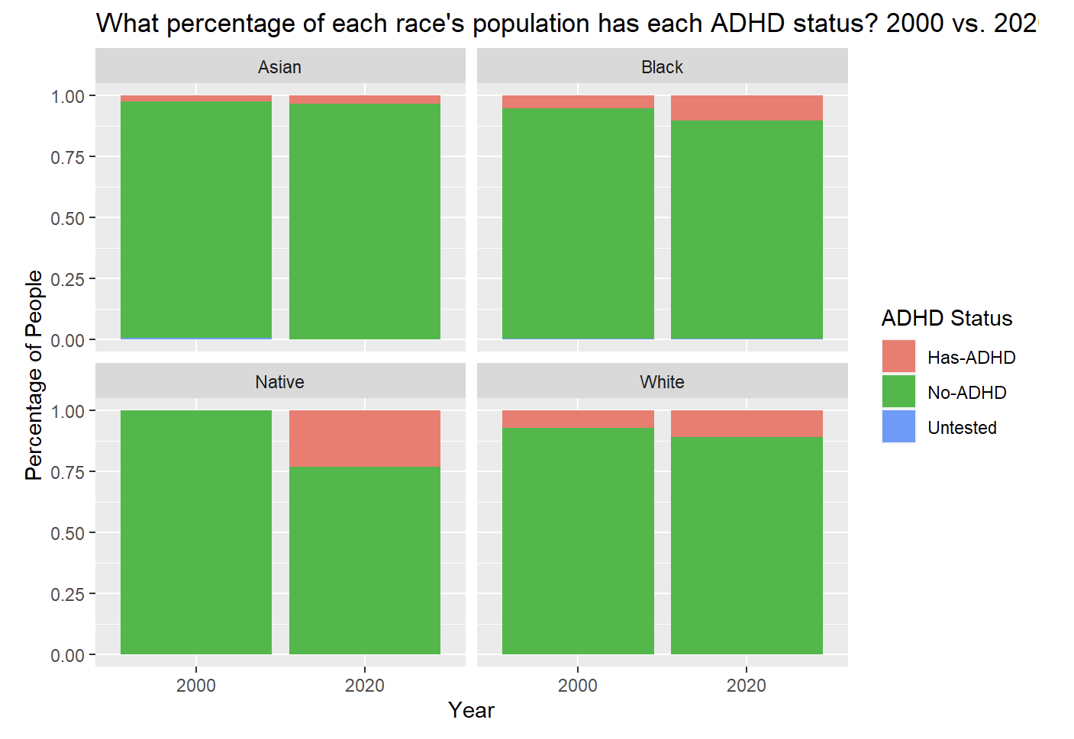

Slide 6
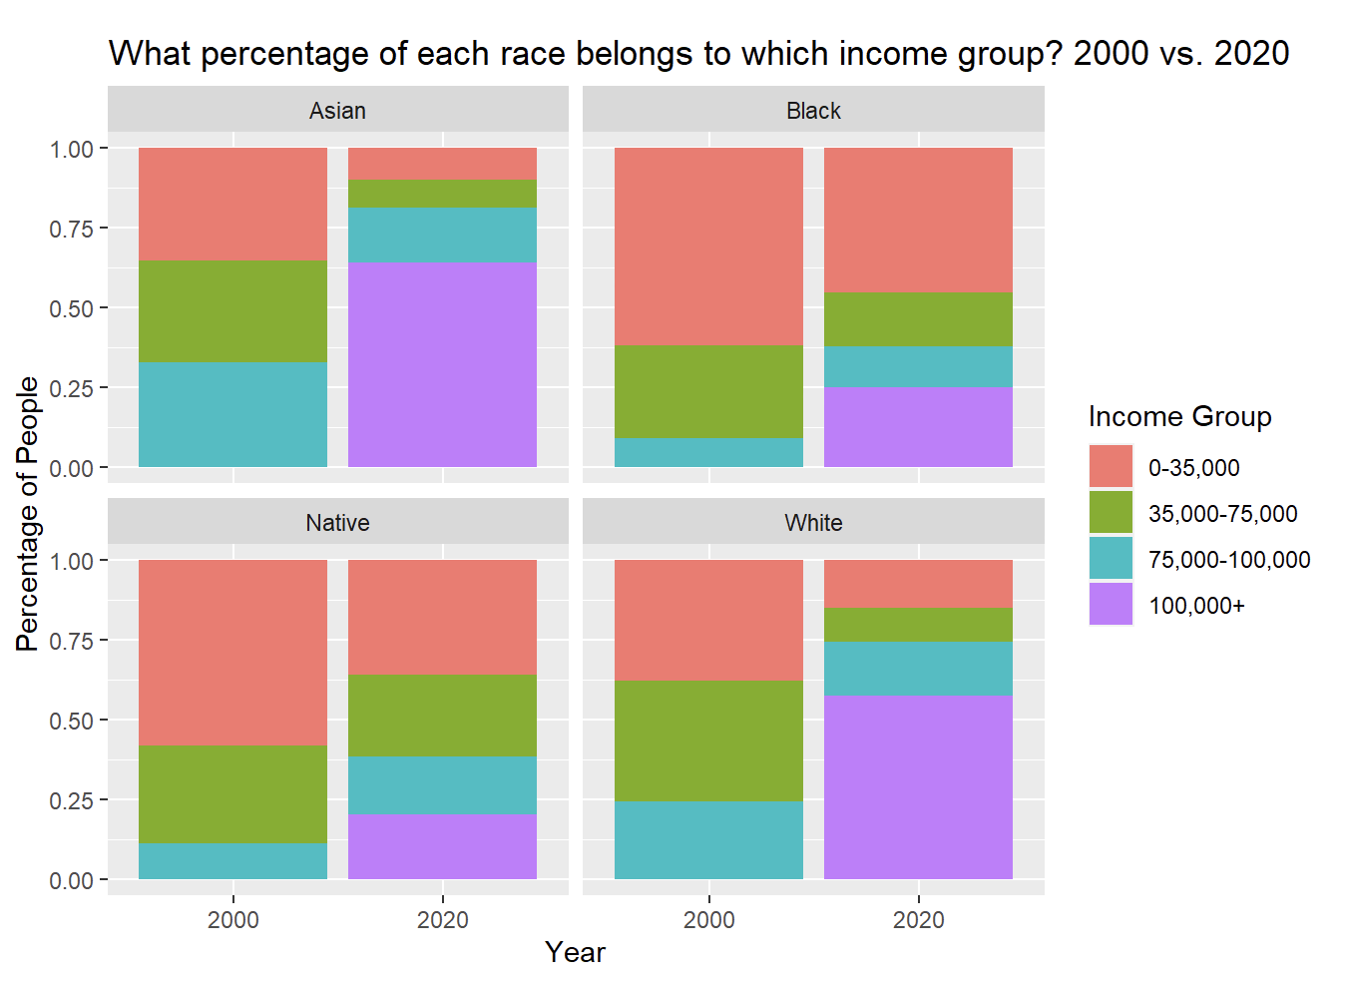

Slide 7
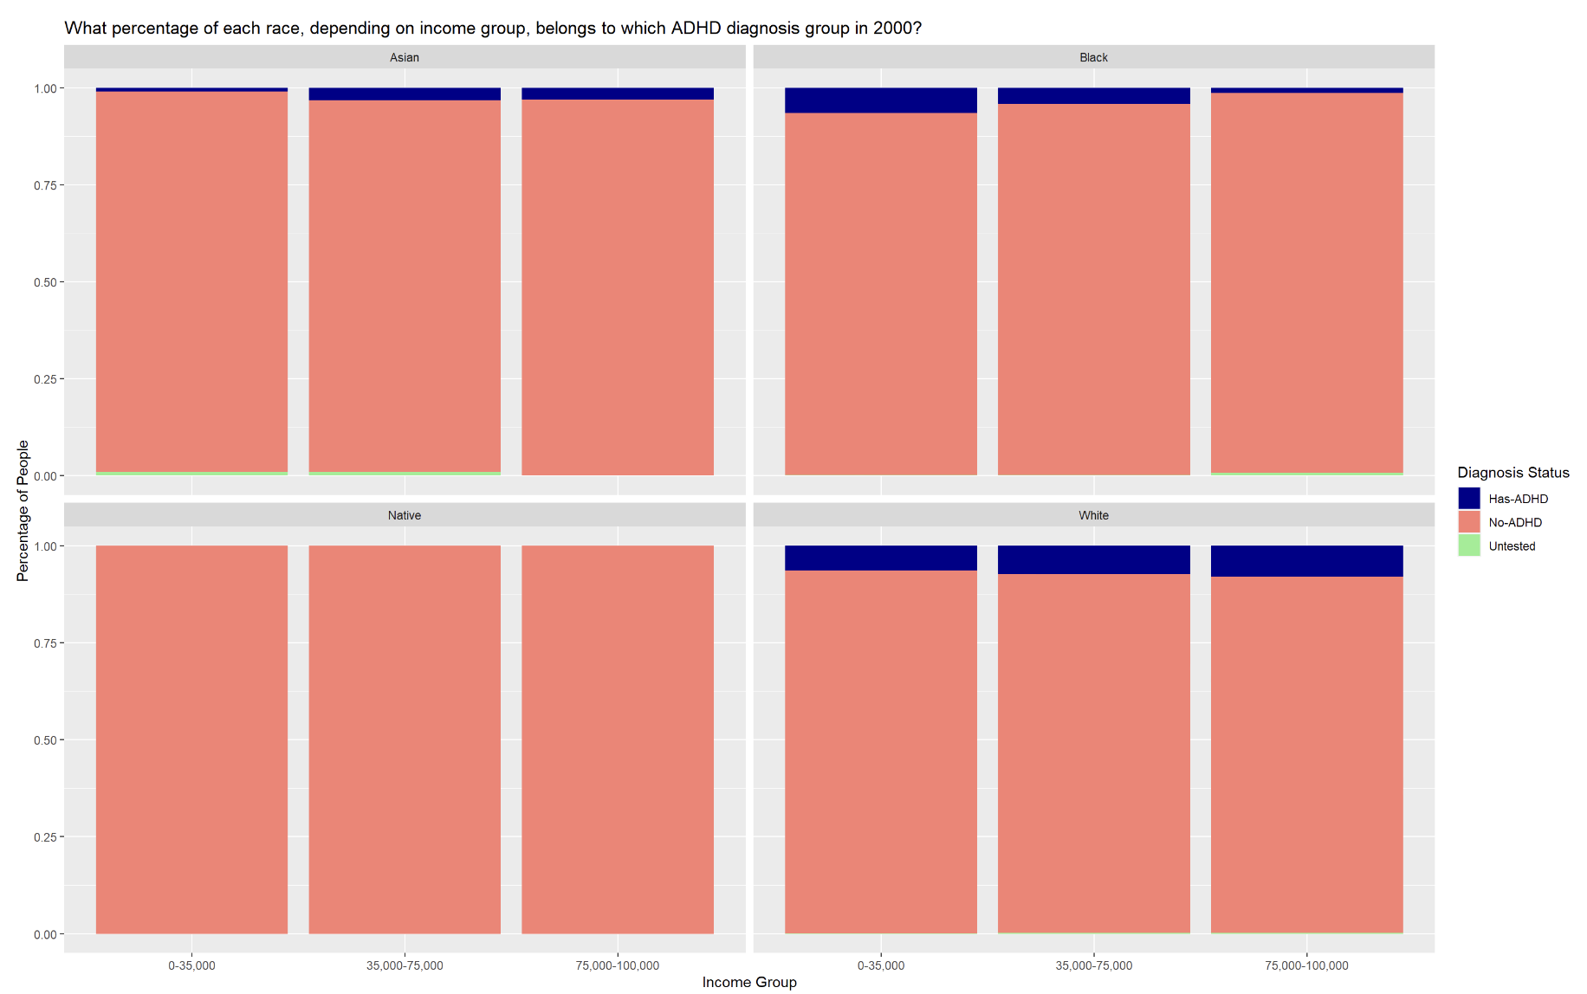

Slide 8
